Slide 1
DonkeyCar Tracing
5조

Slide 2




INDEX
Will enable driving
with the joystick
Learn the driving
using data
Difficult parts
while driving
JoyStick
Learning
Difficult

Slide 3
JoyStick
Will enable driving
with the joystick

Slide 4

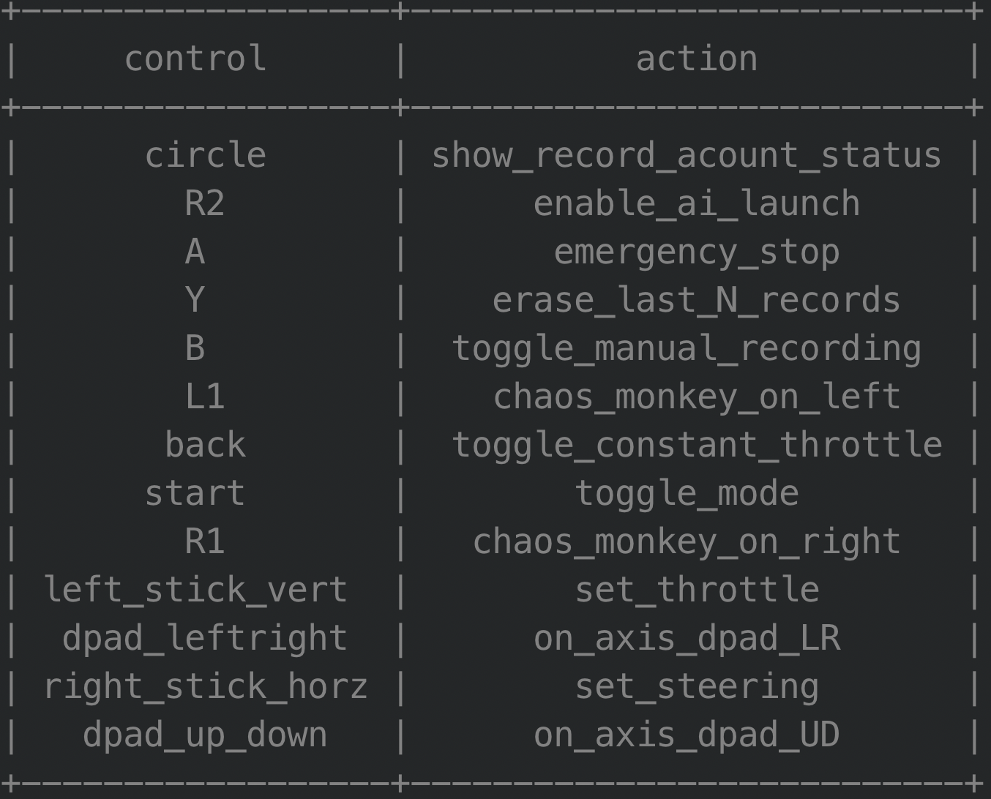
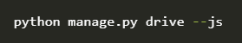
JoyStick
Setup Bluetooth for a wireless control
Change to config.py or run with --js
Joystick user manual

Slide 5

Driving using JoyStick
Driving the donkey car

Slide 6
Learning
Learn the driving
using data

Slide 7

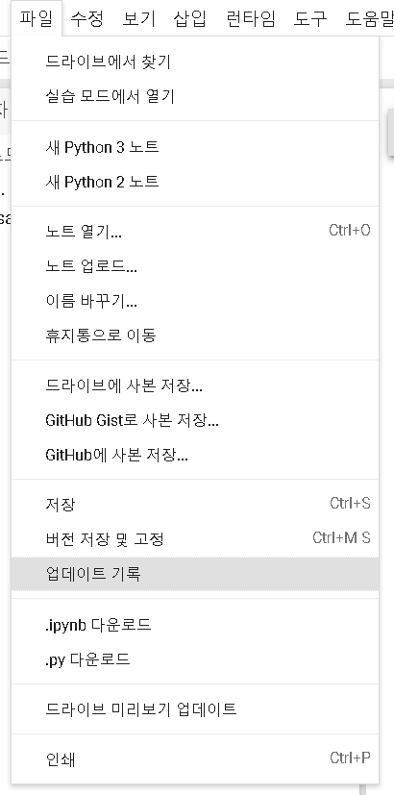
Learning
Learn the driving using data
Install TensorFlow 1.13.1
Check GPU allocation
Git Clone the donkey repository
Install donkey car
Prepare the data
Train the model
Copy trained model to the donkey car

Slide 8
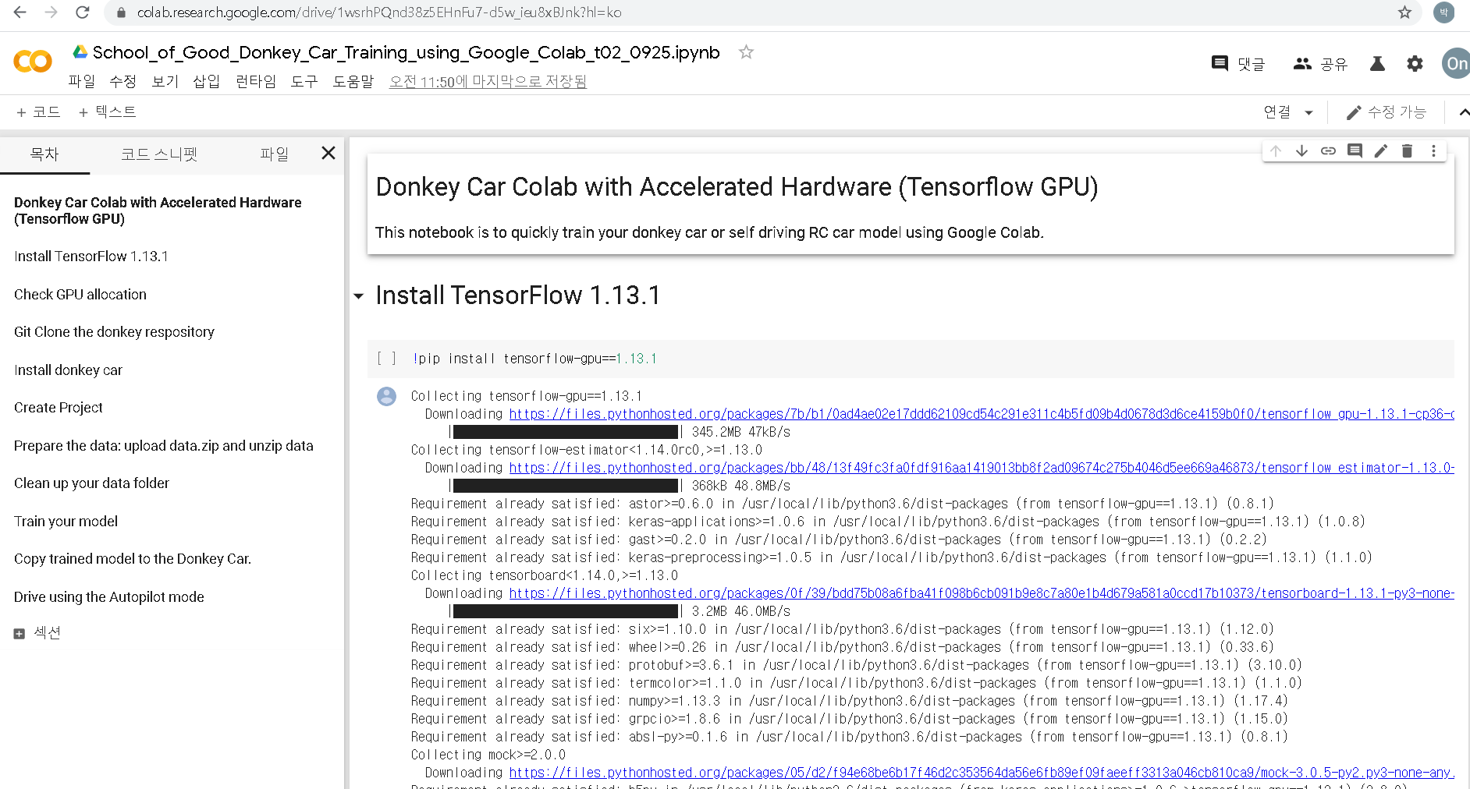
Learning
Learn the driving using data

Slide 9
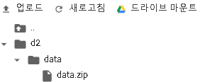
Learning
Learn the driving using data
1. Prepare the data
2. data.zip 파일 생성

Slide 10
Difficult
Difficult parts
while driving

Slide 11

Difficult
Difficult parts while driving
전진은 가능했지만, 후진이 불가능한 문제 발생
IP 번호가 계속 변경
제대로 학습이 되지 않아 주행을 못 함
새롭게 데이터 수집 후 현재 학습 진행 중

Slide 12
THANK YOU

